Slide 1
INSTRUCTIONS – delete this slide after reviewing
This presentation is designed for use if you offer Teladoc Health telehealth services, along with Livongo and/or myStrength programs, meaning you have not migrated to the integrated Teladoc Health experience and will not be migrating prior to 2025.
There are alternative cover slide image options in the appendix that you can select to best represent your population.
Please be sure to only use slides in this presentation that apply to the services your population will have in the next benefit year, and delete any other slides, rather than hiding them. If you are unsure, please contact your Teladoc Health client manager or the client services team.
Each service has several available slides, you can use all of the slides for each service you have, or you can mix and match the slides in that section depending on how much information you want to provide and how long you want your presentation to be.

Slide 2


Open Enrollment Overview Guide
Insert client logo here
2025 Benefit Year
December 4, 2024

Slide 3
Condition Management
A unified approach to getting and staying healthy

Slide 4



Obesity
Obesity is connected to higher risks of anxiety, depression and other mental health conditions¹
Prediabetes
Because chronic conditions are connected
70% of people with prediabetes will eventually be diagnosed with diabetes²
Diabetes
better health requires an approach beyond just disease management
85% of people with type 2 diabetes are overweight or have obesity³
Hypertension
1. CDC. Health effects on overweight and obesity
2. Tabák, A. G., Herder, C., Rathmann, W., Brunner, E. J., & Kivimäki, M. (2012). Prediabetes: a high-risk state for diabetes development. The Lancet, 379(9833), 2279-2290
3. ADA. Help Prevent Diabetes, Treat Obesity
4. CDC. Diabetes and Your Heart
5. Anderson, R. J., Freedland, K. E., Clouse, R. E., & Lustman, P. J. (2001). The prevalence of comorbid depression in adults with diabetes: a meta-analysis. Diabetes care, 24(6), 1069–1078. https://doi.org/10.2337/diacare.24.6.1069
Heart disease is twice as likely to occur in people with diabetes⁴
Mental Health
25% of people with type 2 diabetes have depression⁵
Notes:
Talking Points:
Better health isn’t about one singular metric—A1c, BMI, blood pressure, etc. It’s multi-faceted.
Chronic conditions are connected, so being empowered to live a healthier life requires a broader perspective. Select a couple of stats to mention.
Obesity is connected to higher risks of anxiety, eating disorders and other mental health conditions (Centers for Disease Control and Prevention. Health effects on overweight and obesity. https://www.cdc.gov/healthyweight/effects/index.html)
70% of people with prediabetes will be diagnosed with diabetes without intervention (Tabák, A. G., Herder, C., Rathmann, W., Brunner, E. J., & Kivimäki, M. (2012). Prediabetes: a high-risk state for diabetes development. The Lancet, 379(9833), 2279-2290.)
85% of people with type 2 diabetes are overweight or have obesity (Centers for Disease Control and Prevention. Help Prevent Diabetes, Treat Obesity. https://diabetes.org/obesity)
People with diabetes are twice as likely to have heart disease or a stroke than someone who doesn’t have diabetes (Centers for Disease Control and Prevention. Diabetes and Your Heart. https://www.cdc.gov/diabetes/library/features/diabetes-and-heart.html)
25% of people with type 2 diabetes have depression (Anderson, R. J., Freedland, K. E., Clouse, R. E., & Lustman, P. J. (2001). The prevalence of comorbid depression in adults with diabetes: a meta-analysis. Diabetes care, 24(6), 1069–1078. https://doi.org/10.2337/diacare.24.6.1069)

Slide 5




Condition Management Programs
An overview
Diabetes Management
Diabetes Prevention
Hypertension
Weight Management
Connected blood glucose meter, unlimited strips and lancets, personalized insights, 24/7 expert support for out-of-range readings
Connected weight scale, CDC-approved lessons, food tracking and unlimited access to expert coaching
Connected blood pressure monitor, personalized insights, shareable reports and unlimited access to expert coaching
Connected weight scale, guided content journey, food and activity tracking, and unlimited access to expert coaching
All at no additional cost to you!
Notes:
Use this slide if you have all 4 Condition Management programs. You can remove the programs you don’t offer if you want to keep this slide.

Slide 6
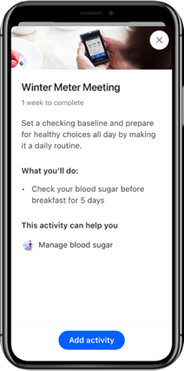
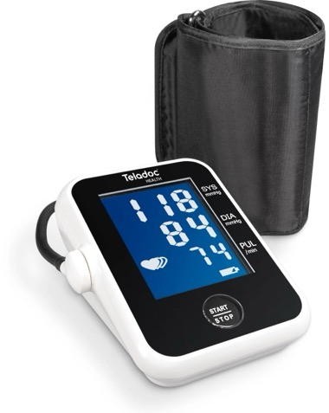
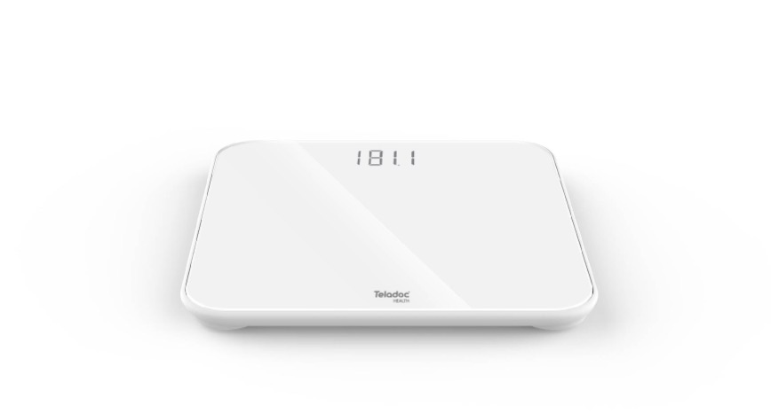
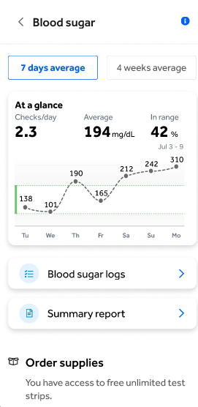
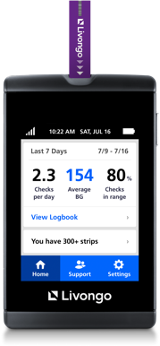
Easy-to-use connected devices
SMART devices allow you to track effortlessly
\
\
\
Diabetes Management
Hypertension Management
Diabetes Prevention and Weight Management
Easy-to-use devices empower you to reach your health goals!
Livongo is now Teladoc Health. We are currently in a brand transition phase. You may receive Livongo branded and Teladoc Health branded products during this phase. Other than the brand name, these products are the same.
Notes:
Use this slide if you have all 4 Condition Management programs. You can remove the programs you don’t offer if you want to keep this slide.
The devices help you by making information accessible and digestible​
All devices are linked your Livongo account out of the box so you can start using yours immediately
It’s an easy process - with no set up, no additional costs and no need to worry about it affecting your mobile data plans​
Data shows that members who use their devices more frequently see:
44% lower A1c
42% lower systolic blood pressure and 35% lower diastolic blood pressure
100% more weight loss
For diabetes: Livongo offer members a proprietary blood glucose meter that enables engagement with you directly in the moment that you’re taking your reading

Slide 7
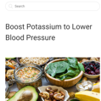
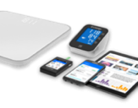
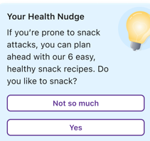
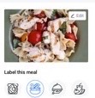
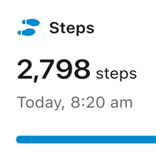

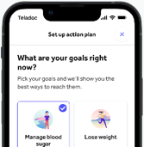
A personalized experience
END-TO-END SUPPORT FOR YOUR ENTIRE HEALTH JOURNEY
\
\
\
\
\
\
\
Health library and lessons
Real-time feedback on devices
Pro tips and Health Nudges™*
Action plan
Food tracking and insights
Activity tracking
1:1 coaching sessions and messaging
* Pro tips and Health NudgesTM are personalized messages for all Condition Management members; they are tailored to where the member is at in their health journey.
Notes:
Within the condition management programs there are different types of support based on your own needs​ - it’s not a one-size-fits-all approach!
If you are comfortable without much assistance, you can use self-directed lessons, device feedback, and tips and nudges to make behavior changes​
More consistent engagement is available with the Action Plan and food tracking feedback​
For members who may need more support, you can build a relationship and connect with a coach​

Slide 8

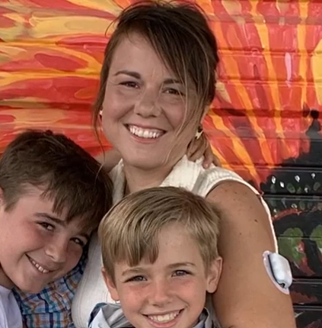

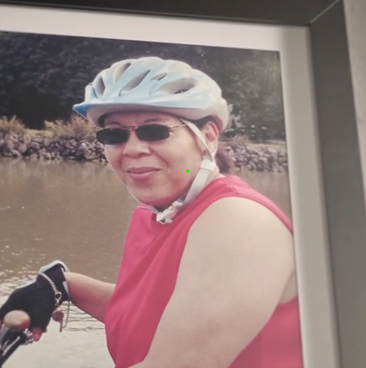



Empowering all people everywhere to live their healthiest lives
Access
Lifestyle
Culture
“
“
“
Within 2.2 seconds a [Livongo] coach immediately called to make sure I was OK
Jamison has type 1 diabetes and lives an hour from care. She suddenly felt ill while driving and pulled over to receive immediate support from Teladoc Health—helping her avoid serious complications.
At the time I worked with nothing but nurses…re-filling test strips started to pile up cost wise
Howie needed more frequent access to coaches and to manage cost to change his behavior. He reduced his A1c from 12.7 to 5.7.
I don’t want to give up my tradition—my rice and beans, tortillas
Irene was waiting all her life to find answers for weight loss. We worked with Irene to develop a nutrition plan that was aligned with her Latin culture. She lost 30 pounds.
https://www.wwltv.com/article/news/health/telehealth-teladoc-diabetes-kenner-man-phone-doctor-symptoms-heart-attack-stroke/289-3148b298-5d6c-4d4d-b328-0ebe8adafed1
https://teladochealth.highspot.com/items/63613d1b843848625f814f82?lfrm=srp.0
https://teladochealth.highspot.com/items/6196751de7355fc88c92fe9d?lfrm=srp.0
The testimonials, statements and opinions presented are applicable only to the individuals depicted. Each member’s exact results and experience will be unique and individual to each member. The testimonials are voluntarily provided and are not paid.
Notes:
Highlight 1-2 testimonials that would resonate with your audience and based on the Condition Management programs you offer.
https://www.wwltv.com/article/news/health/telehealth-teladoc-diabetes-kenner-man-phone-doctor-symptoms-heart-attack-stroke/289-3148b298-5d6c-4d4d-b328-0ebe8adafed1
https://teladochealth.highspot.com/items/63613d1b843848625f814f82?lfrm=srp.0
https://teladochealth.highspot.com/items/6196751de7355fc88c92fe9d?lfrm=srp.0

Slide 9
Diabetes Management
Healthier living made easier

Slide 10


The impact of diabetes
A common, costly disease connected to serious health risks
COSTLY
$327B
U.S. annual spend for diagnosed diabetes²
\
PREVALENT
1 in 10
adults in the U.S. have diabetes—23% are undiagnosed¹
\
HEALTH RISKS
increased risk of complications
1. CDC Diabetes Quick Facts. (2024) https://www.cdc.gov/diabetes/php/data-research/
2. ADA Economic Costs of Diabetes in the U.S. in 2017. Diabetes Care. 2018 May; 41(5): 917-928. https://doi.org/10.2337/dci18-0007
Notes:
Share 1 or 2 statistics from the slide
We believe that when it comes to managing diabetes, there’s a better way forward
Whether you’re someone who lives with one or more conditions or whether you’re responsible for the health and costs of a population, you know there are real challenges:
1 in 10 have diabetes and many don’t even know
It’s especially concerning when it’s undiagnosed because diabetes can lead to more serious complications (stroke, blindness, kidney disease and amputation), so the need to act is now
Combined, it leads to bloating annual costs of diagnosed diabetes--$327 billion
We share this with you because we offer a Diabetes Management program to help those who have been diagnosed.

Slide 11
2.1%
Diabetes Management: Healthier living at no cost to you
Convenient access to device and tools at no extra cost
Receive a connected blood glucose meter
Get reminders on your meter to order more supplies before you run out
Order unlimited strips and lancets delivered to your door
Connected support
See all your blood sugar data in your secure Livongo account
Get real-time tips and insights after every check
Share reports with your doctor
Set goals and reminders, track food and activity, and monitor health trends—all in one place
Receive a weekly email summary with your trends and tools
Guidance from expert coaches
Get 24/7 support for out-of-range readings and unlimited access to one-on-one coaching with Certified Diabetes Care and Education Specialists
Message a coach anytime through your app or online account
Average HbA1c reduction sustained over 5 years¹
48%
Reduced incidence of diabetes over a 3-year period²
96%
Members felt coaching session was personalized to their needs and health goals³
¹ For members starting A1c ≥ 8% at 3 months
² Teladoc Health data
³ Teladoc Health Consumer Marketing Repository, September 2023
Notes:
The Diabetes Management program was created to help those with diabetes lower their A1C and manage their blood sugar long-term.
The program includes unlimited testing strips and lancets (sent right to your door) and a connected blood glucose meter (valued at $200).
This meter also comes with a travel case, so you can easily check your blood sugar on the go.
You'll receive real-time support and feedback on your out-of-range readings from our Diabetes Response Specialists.
You can share reports and download your data anytime from your meter, mobile app or online account.
The Livongo mobile app has tools and features that directly support your personal health goals and needs.
You can use the Action Plan feature to set goals and see your daily progress toward them. And you can log your food and track steps all in one place.
With Message a Coach, you can ask questions and get quick responses through your mobile app or online account.
Members also love the weekly email summaries, with links to seasonal health topics and even more of their own health trends.
Finally, an important, proven to work feature of the program is access to a live, certified coach.
They'll provide motivation and guidance to foster the right mindset for effectively managing diabetes.
Livon

Slide 12
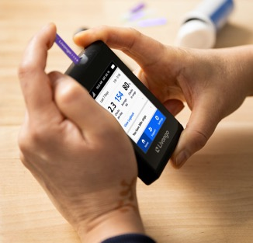


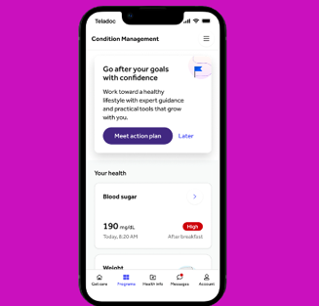
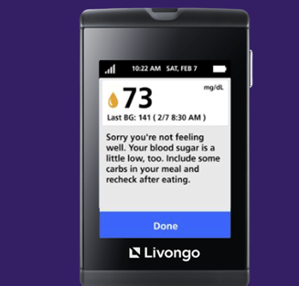
Diabetes Management features
AN overview
Connected blood glucose meter
Unlimited strips and lancets
One-on-one coaching and real-time support
In-app tools and resources
Personalized health signals and Health Nudges™*
*Health NudgesTM are personalized messages for all Condition Management members; they are tailored to where the member is at in their health journey.
Notes:
Here's another look at the key features that are included in your Diabetes Management program, at no additional cost.
Portable blood sugar monitoring: The blood glucose meter provided is designed for convenience, allowing you to easily monitor your blood sugar readings on the go.
Replenish your supplies: With a simple interaction with your meter, you can receive unlimited strips and lancets. You can also order these supplies through the [Teladoc Health] mobile app or your online account.
Expert coaching that's right for you: Our diabetes management coaches are specialists in their field. They offer one-on-one coaching that is adaptable to your schedule, ensuring you have the flexibility to make changes as needed without any commitment.
Our coaching is tailored to fit into your life, focusing on your individual health needs and schedule.
Comprehensive health app: The Teladoc Health mobile app is equipped with all the essential tools to help you stay healthy. It allows you to track your activity, food intake, and blood sugar readings all in one place.
A best-in-class meter experience: If you prefer to use your meter exclusively for managing your health, it’s fully supported. You’ll receive personalized Health Nudges and other personalized insights right on your device.

Slide 13

Tips for building healthy habits
Guidance on increasing activity
Cultural-based meal plan support
Blood sugar monitoring
Strategies to identify & overcome barriers
Problem solving
How Teladoc Health
coaches can help
Accountability
Motivation
Notes:
The Teladoc Health Diabetes Management program expert coaches are here to help you.
Coaches know what works the best when it comes to managing diabetes and staying motivated—they are Certified Diabetes Care and Education Specialists.
They’ll give you tips and techniques for doing paired checks and managing high and low blood sugar readings.
Coaches can guide you to do the right amount of activity, especially if you have limits or pain.
They can also help you stay on track with your medications and help you create plans to stay accountable and overcome barriers.

Slide 14
Ann f., diabetes management member
“It was a super, super bonus because you get all your diabetes supplies with a monitor [at no additional cost]. They actually do your monitoring for you. If you are out of range, they follow up with a text message to whoever you have listed as your emergency contact. Their service is great.
The testimonials, opinions, and statements reflect one member’s personal experience with Teladoc Health. Results and experiences may vary from person to person and will be unique to each member. The testimonials are voluntarily provided and are not paid.
Notes:
Speak to the testimonial and what sticks out most to you

Slide 15
Hypertension Management
Measuring blood pressure just got easier

Slide 16

The impact of hypertension
A common, costly disease connected to serious health risks
COSTLY
$131B
U.S. annual spend for diagnosed hypertension⁴
\
PREVALENT
33+%
of adult physician visits in the U.S. are associated with hypertension¹
\
HEALTH RISKS
increased risk of complications^{2,3}
1. National Ambulatory Medical Care Survey: 2015 State and National Summary Tables 2. Blood Pressure as a Cardiovascular Risk Factor Prevention and Treatment 3. Elevated Blood Pressure and Risk of End-stage Renal Disease in Subjects Without Baseline Kidney Disease 4. Trends in Healthcare Expenditures Among US Adults With Hypertension: National Estimates
Notes:
Main Goal of the Slide:
Give a high-level overview of the prevalence, risks and costs associated with hypertension
Talking Points:
The prevalence of hypertension is high—accounting for 1/3 of all physician office visits
With an ever-growing prevalence, it means more serious complications for more members
Hypertension leads to increased risks of stroke, heart failure, heart attack and kidney disease
Combined, it means a staggering $131 billion annually in the cost of diagnosed hypertension
This is only expected to increase
The “So What?”
Many of your members are likely managing high blood pressure. This is not only a costly challenge in itself but can lead to more serious conditions down the road.

Slide 17
42%
Hypertension Management: Live healthier at no cost to you
Convenient access to a device at no extra cost
Receive a connected blood pressure monitor
Connected support
See all your blood pressure data in your secure Teladoc Health account
Get personalized insights on your blood pressure readings
Share reports with your doctor
Set goals and reminders, track food and activity, and monitor health trends—all in one place
Receive a weekly email summary with your trends and tools
Guidance from expert coaches
Enjoy unlimited access to one-on-one coaching from National Board-Certified Health & Wellness Coaches
Message a coach through your mobile app or online account
Lower systolic blood pressure and 35% lower diastolic blood pressure for members with frequent device use¹
96%
Members felt coaching session was personalized to their needs and health goals²
94%
Members felt coaches gave them confidence to manage their health²
¹ 2023 Teladoc Health CCM metrics
² Teladoc Health Consumer Marketing Repository, September 2023
Notes:
The Hypertension Management program was created to help members manage their high blood pressure and create sustainable heart-healthy habits.
The program includes a connected blood pressure monitor, with a flexible arm cuff.
You'll be encouraged to finish taking 5 blood pressure readings (on 5 different days) to get your baseline blood pressure.
You can easily share reports and download your blood pressure data anytime from your mobile app or online account.
The Livongo mobile app has tools and features that directly support your personal health goals and needs.
You can use the Action Plan feature to set goals and see your daily progress toward them. And you can log your food and track steps all in one place.
With Message a Coach, you can ask questions and get quick responses through your mobile app or online account.
Members also love the weekly email summaries, with links to seasonal health topics and even more of their own health trends.
Finally, an important, proven to work feature of the program is access to a live, certified coach.
They'll provide motivation and guidance to foster the right mindset for effectively managing high blood pressure.

Slide 18
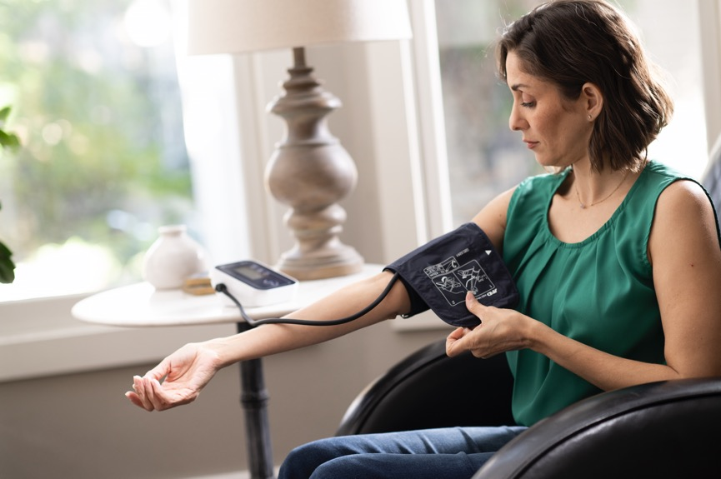
Tips for building healthy habits
Guidance on increasing activity
Cultural-based meal plan support
Goal-setting
Strategies to identify & overcome barriers
Lifestyle management
How Teladoc Health
coaches can help
Accountability
Motivation
Notes:
The Livongo Hypertension Management program expert coaches are here to help you.
Coaches know what works the best when it comes to managing high blood pressure and staying motivated—they are National Board-Certified Health & Wellness Coaches.
They’ll give you tips and techniques for taking your blood pressure accurately and consistently.
Coaches can guide you to do the right amount of activity, especially if you have limits or pain.
They can also help you stay on track with your medications and help you create plans to stay accountable and overcome barriers.

Slide 19


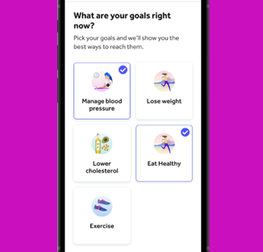
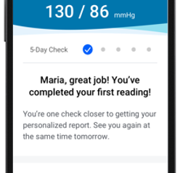
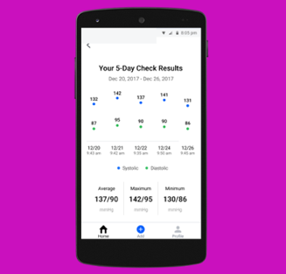
Hypertension Management features
AN overview
Connected blood pressure monitor
One-on-one coaching
In-app tools and resources
Personalized health signals
Baseline blood pressure and health summary reports
Notes:
Here's another look at the key features that are included in your Hypertension Management program, at no additional cost.
Portable blood pressure monitoring: The blood pressure monitor and flexible arm cuff provided is designed for convenience, allowing you to easily monitor your blood pressure on the go.
Expert coaching that's right for you: Our expert coaches are specialists in their field. They offer one-on-one coaching that is adaptable to your schedule, ensuring you have the flexibility to make changes as needed without any commitment.
Our coaching is tailored to fit into your life, focusing on your individual health needs and schedule.
Comprehensive health app: The mobile app is equipped with all the essential tools to help you stay healthy. It allows you to track your activity, food intake, and blood pressure readings all in one place.
A best-in-class experience: You’ll receive personalized Health Nudges and other insights in your Teladoc Health mobile app and online account. You can easily share your reports and data with your doctor.

Slide 20
Melissa n., hypertension management program member
“Through Teladoc and having the app, I can on a daily, weekly and monthly basis, see how my weight is going, see how my blood pressure is going. I’m utilizing it 110% and I'm extremely pleased with this option that I have now, this medical benefit.
The testimonials, opinions, and statements reflect one member’s personal experience with Teladoc Health. Results and experiences may vary from person to person and will be unique to each member. The testimonials are voluntarily provided and are not paid.
Notes:
Speak to the testimonial and what sticks out most to you

Slide 21
Diabetes Prevention Program
Lower your risk of type 2 diabetes

Slide 22

The impact of prediabetes
A prevalent, costly precursor to diabetes that often goes undetected
COSTLY
$44B
U.S. annual spend—often because of unawareness²
\
PREVALENT
1 in 3
adults in the U.S. have prediabetes—that’s about 98 million people¹
\
SILENT
80%
of people with prediabetes are unaware that they have it¹
1. Centers for Disease Control and Prevention, Prediabetes – Your Chance to Prevent Type 2 Diabetes
2. Dall, Timothy M., et al. "The economic burden of elevated blood glucose levels in 2012: diagnosed and undiagnosed diabetes, gestational diabetes mellitus, and prediabetes." Diabetes care 37.12 (2014): 3172-3179.
Notes:
Main Goal of the Slide:
Give a high-level overview of the prevalence, risks and costs associated with prediabetes. Select 1 or 2 of the talking points below to highlight.
Talking Points:
The prevalence of prediabetes is high—1 in 3 adults have prediabetes and only 2 in 10 are aware
The rise in prediabetes is due to growing obesity and weight loss is the first step in reducing incidence of diabetes
A 5-7% weight loss is connected to a 58% reduction in incidences of diabetes
The rising levels of prediabetes leads to increased costs—prediabetes costs our healthcare system $44 billion annually
The “So What?”
Many of your members are likely managing prediabetes. This is not only a costly challenge in itself but can lead to more serious conditions down the road.

Slide 23
(
Clini2
Diabetes Prevention: Healthy living and weight loss tailored to you
Convenient access to a device at no extra cost
Receive a connected weight scale
Connected support
Set goals and reminders, track food and activity, view health trends and monitor progress—all in one place
Access proven tools, CDC-approved lessons and step-by-step action plan to develop healthier habits
Receive a weekly email summary with your trends and tools
Guidance from expert coaches
Enjoy unlimited access to one-on-one coaching from a trained Diabetes Prevention Lifestyle Coach
Message a coach through your mobile app or online account for advice
Learn how to reduce your risk for developing type 2 diabetes
5%
Average weight loss¹
Clinically significant for prediabetes
46%
Of patients lost 5% or more of their starting weight²
48%
Reduced incidence of diabetes over 3 years¹
¹ [DS-2321] Based on retrospective analysis of medical and available pharmacy claims.
² Teladoc health data
Notes:
The Diabetes Prevention program was created to help those with prediabetes lose weight and prevent the onset of type 2 diabetes.
The program includes a connected weight scale.
After you do your first weigh-in, a healthy weight goal will be recommended for you. You change this anytime.
You can easily share reports and download your weight anytime from your mobile app or online account.
The Livongo mobile app has tools and features that directly support your personal health goals and needs.
You'll get a full CDC-approved interactive program, with regular lessons to support your health goals.
You can log your food and track steps all in one place—and the expert coaches will provide you nutrition feedback.
With Message a Coach, you can ask questions and get quick responses through your mobile app or online account.
Members also love the weekly email summaries, with links to seasonal health topics and even more of their own health trends.
Finally, an important, proven to work feature of the program is access to a live, certified coach.
They'll provide motivation and guidance to foster the right mindset for effectively losing weight and preventing the onset of type 2 diabetes.

Slide 24

Tips for building healthy habits
Guidance on increasing activity
Cultural-based meal plan support
Goal-setting
Strategies to identify & overcome barriers
Lifestyle management
How Teladoc Health
coaches can help
Accountability
Motivation
Notes:
The Livongo Diabetes Prevention program expert coaches are here to help you.
Coaches know what works the best when it comes to managing high blood pressure and staying motivated—they are trained Diabetes Prevention Lifestyle Coaches.
They’ll give you tips and techniques for stepping on your scale and logging your food and steps consistently.
Coaches can guide you to do the right amount of activity, especially if you have limits or pain.
They can also help you stay on track with your medications and help you create plans to stay accountable and overcome barriers.

Slide 25


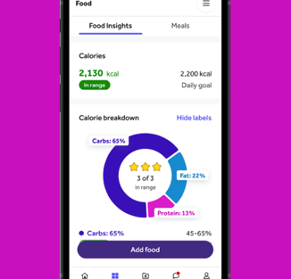

Diabetes Prevention features
AN overview
Connected weight scale
One-on-one coaching
In-app tools, resources and lessons
Personalized nutrition advice
Notes:
Here's another look at the key features that are included in your Diabetes Prevention program, at no additional cost.
Connected weight scale: Our easy-to-use scale helps you track and measure your progress.
Expert coaching that's right for you: Expert coaches are specialists in their field. They offer one-on-one coaching that is adaptable to your schedule, ensuring you have the flexibility to make changes as needed without any commitment.
The coaching is tailored to fit into your life, focusing on your individual health needs and schedule.
Comprehensive health app: The mobile app is equipped with all the essential tools to help you stay healthy. It allows you to track your Diabetes Prevention lesson completion, activity, food intake, and weight all in one place. The coaches will deliver nutrition feedback right to your mobile app and online account.
A best-in-class experience: You’ll receive personalized Health Nudges and other insights in your [Teladoc Health] mobile app and online account. You can easily share your reports and data with your doctor.

Slide 26
Fred v.c., Diabetes prevention program member
“I found it to be a very good program in that I don’t have to do anything different, I don’t have to count calories. I just need to eat smarter.
The testimonials, opinions, and statements reflect one member’s personal experience with Teladoc Health. Results and experiences may vary from person to person and will be unique to each member. The testimonials are voluntarily provided and are not paid.
Notes:
Speak to the testimonial and what sticks out most to you

Slide 27
Weight Management
Your journey to healthier living

Slide 28


Obesity is an expensive and challenging disease to treat
\
COSTLY
a highly prevalent, costly and complex chronic disease
$173B
U.S. annual spend on obesity-related care²
\
PREVALENT
41.9%
of the U.S. adult population lives with obesity (BMI 30+), of which 9.2% have severe obesity (BMI 40+)¹
\
COMPLEX
a lifelong disease with periods of elevated risk, control and recurrence
CDC Adult Obesity Facts
Piper Sandler Industry Note: September 12, 2023
Notes:
Pick out a few statistics to share
Talking Points:
The prevalence of overweight/obesity is high
42% of adults in the U.S. have obesity with 10% having severe obesity
If you broaden it out to include people who are overweight—2 in 3 adults are overweight or have obesity (a BMI > 25)
Annual spending on obesity and obesity-related is care is costly—largely because of the link to other serious chronic conditions
Weight is attributable to 57% of diabetes diagnoses; 70% of MSK issues and 41% of respiratory conditions, including sleep apnea
And what we’re continuing to learn is that obesity is a complex disease
It is something people have for their life and there’s no silver bullet when it comes to treating it

Slide 29
(
Clini2
5%
Weight Management: Weight loss tailored to you
Convenient access to a device at no extra cost
Receive a connected weight scale
Connected support
Set goals and reminders, track food and activity, view weight trends and progress—all in one place
Learn techniques to lose and maintain a healthy weight via guided lessons covering the latest in behavioral science
Access proven tools and step-by-step action plan to develop healthier habits and achieve your goals
Receive a weekly email summary with your trends and tools
Guidance from expert coaches
Enjoy unlimited access to one-on-one coaching
Message a coach through your mobile app or online account for advice
Get personalized strategies for improving nutrition, planning meals, increasing activity and more
Average weight loss¹
Clinically significant for prediabetes
46%
Of patients lost 5% or more of their starting weight²
96%
Of members felt coaching session was personalized to their needs and health goals²
¹ [DS-2321] Based on retrospective analysis of medical and available pharmacy claims.
² Teladoc Health data
³ Teladoc Health Consumer Marketing Repository September 2023
Notes:
The Weight Management program was designed to help members lose (and maintain a healthy) weight.
The program includes a connected weight scale.
After you do your first weigh-in, a healthy weight goal will be recommended for you. You change this anytime.
You can easily share reports and download your weight anytime from your mobile app or online account.
The Livongo mobile app has tools and features that directly support your personal health goals and needs.
You'll get a full guided program, with regular lessons using the best in behavior science techniques to support your health goals.
You can log your food and track steps all in one place—and the expert coaches will provide you nutrition feedback.
With Message a Coach, you can ask questions and get quick responses through your mobile app or online account.
Members also love the weekly email summaries, with links to seasonal health topics and even more of their own health trends.
Finally, an important, proven to work feature of the program is access to a live, certified coach.
They'll provide motivation and guidance to foster the right mindset for effectively losing weight and living a healthier life.

Slide 30
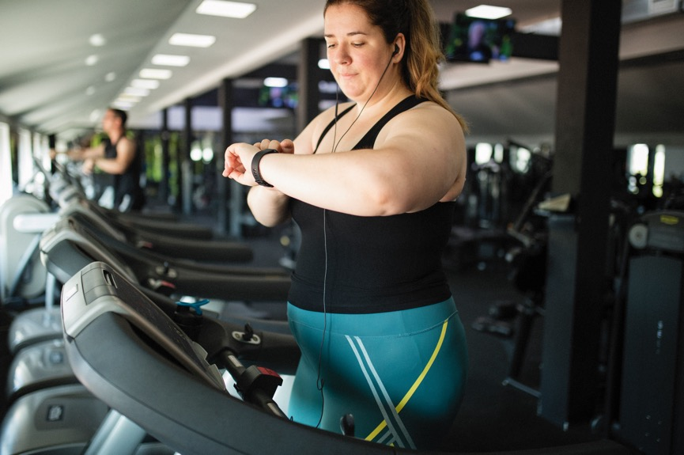
Tips for building healthy habits
Guidance on increasing activity
Cultural-based meal plan support
Goal-setting
Strategies to identify & overcome barriers
Lifestyle management
How Teladoc Health
coaches can help
Accountability
Motivation
Notes:
The Livongo Weight Management program expert coaches are here to help you.
Coaches know what works the best when it comes to losing and managing weight and staying motivated.
They’ll give you tips and techniques for stepping on your scale and logging your food and steps consistently.
Coaches can guide you to do the right amount of activity, especially if you have limits or pain.
They can also help you stay on track with your medications and help you create plans to stay accountable and overcome barriers.

Slide 31



Weight Management features
AN overview
Connected weight scale
One-on-one coaching
Food tracking and insights
In-app tools and resources
Guided lessons
Notes:
Here's another look at the key features that are included in your Weight Management program, at no additional cost.
Connected weight scale: The easy-to-use scale helps you track and measure your progress.
Expert coaching that's right for you: [Teladoc Health] expert coaches are specialists in their field. They offer one-on-one coaching that is adaptable to your schedule, ensuring you have the flexibility to make changes as needed without any commitment.
Coaching is tailored to fit into your life, focusing on your individual health needs and schedule.
Comprehensive health app: The mobile app is equipped with all the essential tools to help you stay healthy. It allows you to track your Weight Management lesson completion, activity, food intake, and weight all in one place. The coaches will deliver nutrition feedback right to your mobile app and online account.
A best-in-class experience: You’ll receive personalized Health Nudges and other insights in your Teladoc Health mobile app and online account. You can easily share your reports and data with your doctor.

Slide 32
Suzanne b., weight management program member
“I think sometimes I get so excited about my progress now and how the app has really helped me, how the program overall has helped me. I think, ‘Gosh, where would I have been 20 years ago if I'd had it 20 years ago to help me.
The testimonials, opinions, and statements reflect one member’s personal experience with Teladoc Health. Results and experiences may vary from person to person and will be unique to each member. The testimonials are voluntarily provided and are not paid.
Notes:
Speak to the testimonial and what sticks out most to you

Slide 33
Condition Management
Condition Management Plus
Your journey to healthier living

Slide 34
Obesity
Obesity is connected to higher risks of anxiety, depression and other mental health conditions¹
Prediabetes
Because chronic conditions are connected
70% of people with prediabetes will eventually be diagnosed with diabetes²
Diabetes
better health requires an approach beyond just disease management
85% of people with type 2 diabetes are overweight or have obesity³
Hypertension
1. CDC. Health effects on overweight and obesity
2. Tabák, A. G., Herder, C., Rathmann, W., Brunner, E. J., & Kivimäki, M. (2012). Prediabetes: a high-risk state for diabetes development. The Lancet, 379(9833), 2279-2290
3. ADA. Help Prevent Diabetes, Treat Obesity
4. CDC. Diabetes and Your Heart
5. Anderson, R. J., Freedland, K. E., Clouse, R. E., & Lustman, P. J. (2001). The prevalence of comorbid depression in adults with diabetes: a meta-analysis. Diabetes care, 24(6), 1069–1078. https://doi.org/10.2337/diacare.24.6.1069
Heart disease is twice as likely to occur in people with diabetes⁴
Mental Health
25% of people with type 2 diabetes have depression⁵
Notes:
Talking Points:
Better health isn’t about one singular metric—A1c, BMI, blood pressure, etc. It’s multi-faceted.
Chronic conditions are connected, so being empowered to live a healthier life requires a broader perspective. Select a couple of stats to mention.
Obesity is connected to higher risks of anxiety, eating disorders and other mental health conditions (Centers for Disease Control and Prevention. Health effects on overweight and obesity. https://www.cdc.gov/healthyweight/effects/index.html)
70% of people with prediabetes will be diagnosed with diabetes without intervention (Tabák, A. G., Herder, C., Rathmann, W., Brunner, E. J., & Kivimäki, M. (2012). Prediabetes: a high-risk state for diabetes development. The Lancet, 379(9833), 2279-2290.)
85% of people with type 2 diabetes are overweight or have obesity (Centers for Disease Control and Prevention. Help Prevent Diabetes, Treat Obesity. https://diabetes.org/obesity)
People with diabetes are twice as likely to have heart disease or a stroke than someone who doesn’t have diabetes (Centers for Disease Control and Prevention. Diabetes and Your Heart. https://www.cdc.gov/diabetes/library/features/diabetes-and-heart.html)
25% of people with type 2 diabetes have depression (Anderson, R. J., Freedland, K. E., Clouse, R. E., & Lustman, P. J. (2001). The prevalence of comorbid depression in adults with diabetes: a meta-analysis. Diabetes care, 24(6), 1069–1078. https://doi.org/10.2337/diacare.24.6.1069)

Slide 35
Diabetes Management
Diabetes Management Plus
Healthier living made easier

Slide 36
The impact of diabetes
A common, costly disease connected to serious health risks
COSTLY
$327B
U.S. annual spend for diagnosed diabetes²
\
PREVALENT
1 in 10
adults in the U.S. have diabetes—23% are undiagnosed¹
\
HEALTH RISKS
increased risk of complications
1. CDC Diabetes Quick Facts. (2024) https://www.cdc.gov/diabetes/php/data-research/
2. ADA Economic Costs of Diabetes in the U.S. in 2017. Diabetes Care. 2018 May; 41(5): 917-928. https://doi.org/10.2337/dci18-0007
Notes:
Share 1 or 2 statistics from the slide
We believe that when it comes to managing diabetes, there’s a better way forward
Whether you’re someone who lives with one or more conditions or whether you’re responsible for the health and costs of a population, you know there are real challenges:
1 in 10 have diabetes and many don’t even know
It’s especially concerning when it’s undiagnosed because diabetes can lead to more serious complications (stroke, blindness, kidney disease and amputation), so the need to act is now
Combined, it leads to bloating annual costs of diagnosed diabetes--$327 billion
We share this with you because we offer a Diabetes Management program to help those who have been diagnosed.

Slide 37
Diabetes Management Plus
2.1%
Diabetes Management: Healthier living at no cost to you
Convenient access to devices and tools at no extra cost
Receive a connected blood glucose meter
Order unlimited strips and lancets delivered to your door
You may also be eligible for additional tools and devices, including a connected blood pressure monitor, connected weight scale and digital tools to support your mental health
Connected support
See all your blood sugar data in your secure [Teladoc Health] account
Get real-time tips and insights after every check
Set goals and reminders, track food and activity, and monitor health trends—all in one place
Receive a weekly email summary with your trends and tools
Guidance from expert coaches
Get 24/7 support for out-of-range readings and unlimited access to one-on-one coaching with Certified Diabetes Care and Education Specialists
Message a coach anytime through your app or online account
Average HbA1c reduction sustained over 5 years¹
48%
Reduced incidence of diabetes over a 3-year period²
96%
Members felt coaching session was personalized to their needs and health goals³
¹ For members starting A1c ≥ 8% at 3 months
² Teladoc Health data
³ Teladoc Health Consumer Marketing Repository, September 2023
Notes:
The Diabetes Management program was created to help those diagnosed with diabetes lower their A1C and manage their blood sugar long-term.
The program includes unlimited testing strips and lancets (sent right to your door) and a connected blood glucose meter (valued at $200).
This meter also comes with a travel case, so you can easily check your blood sugar on the go.
You'll receive real-time support and feedback on your out-of-range readings from our Diabetes Response Specialists.
You can share reports and download your data anytime from your meter, mobile app or online account.
Eligible members may also receive additional tools and devices to help them manage their blood pressure, weight and mental health.
The Livongo mobile app has tools and features that directly support your personal health goals and needs.
You can use the Action Plan feature to set goals and see your daily progress toward them. And you can log your food and track steps all in one place.
With Message a Coach, you can ask questions and get quick responses through your mobile app or online account.
Members also love the weekly email summaries, with links to seasonal health topics and even more of their own health trends.
Finally, an important, proven to work feature of the program is access to a live, certified coach.
They'll provide motivation and guidance to foster the right mindset for effectively managing diabetes.

Slide 38
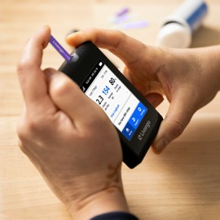


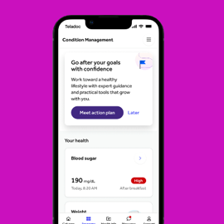
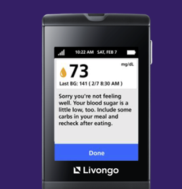
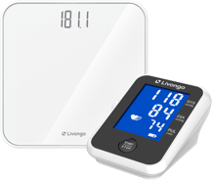
Diabetes Management features
Diabetes Management Plus
AN overview
Connected blood glucose meter
Unlimited strips and lancets
One-on-one coaching and real-time support
In-app tools and resources
Personalized health signals and Health Nudges™*
Additional devices and tools (for eligible members)
*Health NudgesTM are personalized messages for all Condition Management members; they are tailored to where the member is at in their health journey.
Notes:
Here's another look at the key features that are included in your Diabetes Management program, at no additional cost.
Portable blood sugar monitoring: The blood glucose meter provided is designed for convenience, allowing you to easily monitor your blood sugar readings on the go.
Replenish your supplies: With a simple interaction with your meter, you can receive unlimited strips and lancets. You can also order these supplies through the [Teladoc Health] mobile app or your online account.
Expert coaching that's right for you: The diabetes management coaches are specialists in their field. They offer one-on-one coaching that is adaptable to your schedule, ensuring you have the flexibility to make changes as needed without any commitment.
Coaching is tailored to fit into your life, focusing on your individual health needs and schedule.
Comprehensive health app: The mobile app is equipped with all the essential tools to help you stay healthy. It allows you to track your activity, food intake, and blood sugar readings all in one place.
A best-in-class meter experience: If you prefer to use your meter exclusively for managing your health, it’s fully supported. You’ll receive personalized Health Nudges and other personalized insights right on your device.
Eligible members may also receive additional devices and tools to help them manage other aspects of their health.

Slide 39
Tips for building healthy habits
Guidance on increasing activity
Cultural-based meal plan support
Blood sugar monitoring
Strategies to identify & overcome barriers
Problem solving
How Teladoc Health
coaches can help
Accountability
Motivation
Notes:
The Livongo Diabetes Management program expert coaches are here to help you.
Coaches know what works the best when it comes to managing diabetes and staying motivated—they are Certified Diabetes Care and Education Specialists.
They’ll give you tips and techniques for doing paired checks and managing high and low blood sugar readings.
Coaches can guide you to do the right amount of activity, especially if you have limits or pain.
They can also help you stay on track with your medications and help you create plans to stay accountable and overcome barriers.

Slide 40
Ann f., diabetes management member
“It was a super, super bonus because you get all your diabetes supplies with a monitor [at no additional cost]. They actually do your monitoring for you. If you are out of range, they follow up with a text message to whoever you have listed as your emergency contact. Their service is great.
The testimonials, opinions, and statements reflect one member’s personal experience with Teladoc Health. Results and experiences may vary from person to person and will be unique to each member. The testimonials are voluntarily provided and are not paid.
Notes:
Speak to the testimonial and what sticks out most to you

Slide 41
Hypertension Management
Hypertension Management Plus
Measuring blood pressure just got easier

Slide 42
The impact of hypertension
A common, costly disease connected to serious health risks
COSTLY
$131B
U.S. annual spend for diagnosed hypertension⁴
\
PREVALENT
33+%
of adult physician visits in the U.S. are associated with hypertension¹
\
HEALTH RISKS
increased risk of complications^{2,3}
1. National Ambulatory Medical Care Survey: 2015 State and National Summary Tables 2. Blood Pressure as a Cardiovascular Risk Factor Prevention and Treatment 3. Elevated Blood Pressure and Risk of End-stage Renal Disease in Subjects Without Baseline Kidney Disease 4. Trends in Healthcare Expenditures Among US Adults With Hypertension: National Estimates
Notes:
Select a few statistics to speak to.
Talking Points:
The prevalence of hypertension is high—accounting for 1/3 of all physician office visits
With an ever-growing prevalence, it means more serious complications for more members
Hypertension leads to increased risks of stroke, heart failure, heart attack and kidney disease
Combined, it means a staggering $131 billion annually in the cost of diagnosed hypertension
This is only expected to increase

Slide 43
Hypertension Management Plus
42%
Hypertension Management: Live healthier at no cost to you
Convenient access to devices and tools at no extra cost
Receive a connected blood pressure monitor
You may also be eligible for a connected weight scale and digital tools to support your mental health
Connected support
See all your blood pressure data in your secure [Teladoc Health] account
Get personalized insights on your blood pressure readings
Share reports with your doctor
Set goals and reminders, track food and activity, and monitor health trends—all in one place
Receive a weekly email summary with your trends and tools
Guidance from expert coaches
Enjoy unlimited access to one-on-one coaching from National Board-Certified Health & Wellness Coaches
Message a coach through your mobile app or online account
Lower systolic blood pressure and 35% lower diastolic blood pressure for members with frequent device use¹
96%
Members felt coaching session was personalized to their needs and health goals²
94%
Members felt coaches gave them confidence to manage their health²
¹ 2023 Teladoc Health CCM metrics
² Teladoc Health Consumer Marketing Repository, September 2023
Notes:
The Hypertension Management program was created to help members manage their high blood pressure and create sustainable heart-healthy habits.
The program includes a connected blood pressure monitor, with a flexible arm cuff.
You'll be encouraged to finish taking 5 blood pressure readings (on 5 different days) to get your baseline blood pressure.
You can easily share reports and download your blood pressure data anytime from your mobile app or online account.
Eligible members may also receive additional tools and devices to help them manage their weight and mental health.
The Livongo mobile app has tools and features that directly support your personal health goals and needs.
You can use the Action Plan feature to set goals and see your daily progress toward them. And you can log your food and track steps all in one place.
With Message a Coach, you can ask questions and get quick responses through your mobile app or online account.
Members also love our weekly email summaries, with links to seasonal health topics and even more of their own health trends.
Finally, an important, proven to work feature of the program is access to a live, certified coach.
They'll provide motivation and guidance to foster the right mindset for effectively managing high blood pressure.

Slide 44
Tips for building healthy habits
Guidance on increasing activity
Cultural-based meal plan support
Goal-setting
Strategies to identify & overcome barriers
Lifestyle management
How Teladoc Health
coaches can help
Accountability
Motivation
Notes:
The Livongo Hypertension Management program expert coaches are here to help you.
Coaches know what works the best when it comes to managing high blood pressure and staying motivated—they are National Board-Certified Health & Wellness Coaches.
They’ll give you tips and techniques for taking your blood pressure accurately and consistently.
Coaches can guide you to do the right amount of activity, especially if you have limits or pain.
They can also help you stay on track with your medications and help you create plans to stay accountable and overcome barriers.

Slide 45


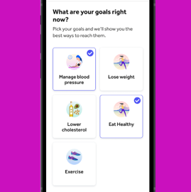
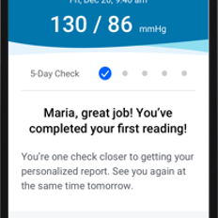

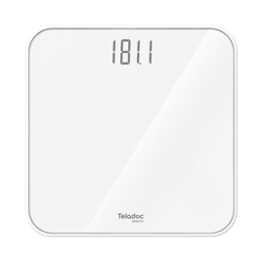
Hypertension Management features
Hypertension Management Plus
AN overview
Connected blood pressure monitor
One-on-one coaching
In-app tools and resources
Personalized health signals
Baseline blood pressure and health summary reports
Additional connected weight scale and tools (for eligible members)
Notes:
Here's another look at the key features that are included in your Hypertension Management program, at no additional cost.
Portable blood pressure monitoring: The blood pressure monitor and flexible arm cuff provided is designed for convenience, allowing you to easily monitor your blood pressure on the go.
Expert coaching that's right for you: The expert coaches are specialists in their field. They offer one-on-one coaching that is adaptable to your schedule, ensuring you have the flexibility to make changes as needed without any commitment.
Coaching is tailored to fit into your life, focusing on your individual health needs and schedule.
Comprehensive health app: The mobile app is equipped with all the essential tools to help you stay healthy. It allows you to track your activity, food intake, and blood pressure readings all in one place.
A best-in-class experience: You’ll receive personalized Health Nudges and other insights in your [Teladoc Health] mobile app and online account. You can easily share your reports and data with your doctor.

Slide 46
Melissa n., hypertension management program member
“Through Teladoc and having the app, I can on a daily, weekly and monthly basis see how my weight is going, see how my blood pressure is going. I’m utilizing it 110% and I’m extremely pleased with this option that I have now, this medical benefit.
The testimonials, opinions, and statements reflect one member’s personal experience with Teladoc Health. Results and experiences may vary from person to person and will be unique to each member. The testimonials are voluntarily provided and are not paid.
Notes:
Speak to the testimonial and what sticks out most to you

Slide 47
Diabetes Prevention Program
Diabetes Prevention Plus
Lower your risk of type 2 diabetes

Slide 48
The impact of prediabetes
A prevalent, costly precursor to diabetes that often goes undetected
COSTLY
$44B
U.S. annual spend—often because of unawareness²
\
PREVALENT
1 in 3
adults in the U.S. have prediabetes—that’s about 98 million people¹
\
SILENT
80%
of people with prediabetes are unaware that they have it¹
1. Centers for Disease Control and Prevention, Prediabetes – Your Chance to Prevent Type 2 Diabetes
2. Dall, Timothy M., et al. "The economic burden of elevated blood glucose levels in 2012: diagnosed and undiagnosed diabetes, gestational diabetes mellitus, and prediabetes." Diabetes care 37.12 (2014): 3172-3179.
Notes:
Main Goal of the Slide:
Give a high-level overview of the prevalence, risks and costs associated with prediabetes. Select 1-2 stats to point out.
Talking Points:
The prevalence of prediabetes is high—1 in 3 adults have prediabetes and only 2 in 10 are aware
The rise in prediabetes is due to growing obesity and weight loss is the first step in reducing incidence of diabetes
A 5-7% weight loss is connected to a 58% reduction in incidences of diabetes
The rising levels of prediabetes leads to increased costs—prediabetes costs our healthcare system $44 billion annually
The “So What?”
Many of your members are likely managing prediabetes. This is not only a costly challenge in itself but can lead to more serious conditions down the road.

Slide 49
(
Clini2
Diabetes Prevention Plus
Diabetes Prevention: Healthy living and weight loss tailored to you
Convenient access to devices and tools at no extra cost
Receive a connected weight scale
You may also be eligible for a connected blood pressure monitor and digital tools to support your mental health
Connected support
Set goals and reminders, track food and activity, view health trends and monitor progress—all in one place
Access proven tools, CDC-approved lessons and step-by-step action plan to develop healthier habits
Receive a weekly email summary with your trends and tools
Guidance from expert coaches
Enjoy unlimited access to one-on-one coaching from a trained Diabetes Prevention Lifestyle Coach
Message a coach through your mobile app or online account for advice
Learn how to reduce your risk for developing type 2 diabetes
5%
Average weight loss¹
Clinically significant for prediabetes
46%
Of patients lost 5% or more of their starting weight²
48%
Reduced incidence of diabetes over 3 years¹
¹ [DS-2321] Based on retrospective analysis of medical and available pharmacy claims.
² Teladoc health data
Notes:
The Diabetes Prevention program was created to help those with prediabetes lose weight and prevent the onset of type 2 diabetes.
The program includes a connected weight scale.
After you do your first weigh-in, we'll recommend a healthy weight goal for you. You change this anytime.
You can easily share reports and download your weight anytime from your mobile app or online account.
Eligible members may also receive additional tools and devices to help them manage their blood pressure and mental health.
The Livongo mobile app has tools and features that directly support your personal health goals and needs.
You'll get a full CDC-approved interactive program, with regular lessons to support your health goals.
You can log your food and track steps all in one place—and our expert coaches will provide you nutrition feedback.
With Message a Coach, you can ask questions and get quick responses through your mobile app or online account.
Members also love the weekly email summaries, with links to seasonal health topics and even more of their own health trends.
Finally, an important, proven to work feature of the program is access to a live, certified coach.
They'll provide motivation and guidance to foster the right mindset for effectively losing weight and preventing the onset of type 2 diabetes.

Slide 50
Tips for building healthy habits
Guidance on increasing activity
Cultural-based meal plan support
Goal-setting
Strategies to identify & overcome barriers
Lifestyle management
How Teladoc Health
coaches can help
Accountability
Motivation
Notes:
The Livongo Diabetes Prevention program expert coaches are here to help you.
Coaches know what works the best when it comes to managing high blood pressure and staying motivated—they are trained Diabetes Prevention Lifestyle Coaches.
They’ll give you tips and techniques for stepping on your scale and logging your food and steps consistently.
Coaches can guide you to do the right amount of activity, especially if you have limits or pain.
They can also help you stay on track with your medications and help you create plans to stay accountable and overcome barriers.

Slide 51


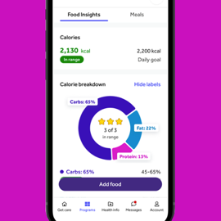

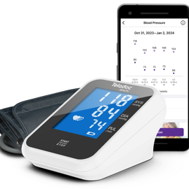
Diabetes Prevention features
Diabetes Prevention Plus
AN overview
Connected weight scale
One-on-one coaching
In-app tools, resources and lessons
Personalized nutrition advice
Connected blood pressure monitor (for eligible members)
Notes:
Here's another look at the key features that are included in your Diabetes Prevention program, at no additional cost.
Connected weight scale: The easy-to-use scale helps you track and measure your progress.
Expert coaching that's right for you: Expert coaches are specialists in their field. They offer one-on-one coaching that is adaptable to your schedule, ensuring you have the flexibility to make changes as needed without any commitment.
Coaching is tailored to fit into your life, focusing on your individual health needs and schedule.
Comprehensive health app: The mobile app is equipped with all the essential tools to help you stay healthy. It allows you to track your Diabetes Prevention lesson completion, activity, food intake, and weight all in one place. Coaches will deliver nutrition feedback right to your mobile app and online account.
A best-in-class experience: You’ll receive personalized Health Nudges and other insights in your [Teladoc Health] mobile app and online account. You can easily share your reports and data with your doctor.
Eligible members may also receive additional tools and devices to help them manage their blood pressure, and mental health.

Slide 52
Fred v.c., Diabetes prevention program member
“I found it to be a very good program in that I don’t have to do anything different, I don’t have to count calories. I just need to eat smarter.
The testimonials, opinions, and statements reflect one member’s personal experience with Teladoc Health. Results and experiences may vary from person to person and will be unique to each member. The testimonials are voluntarily provided and are not paid.
Notes:
Speak to the testimonial and what sticks out most to you

Slide 53
Please Read – delete this slide after reviewing
The Chronic Care Management slides in this section cover the bundled COMPLETE programs that include a physician’s care.
Delete the slides you don't need then remove the highlighted name, if applicable, on each title slide. The highlight is only for your information, so you know you're sharing the correct product. It is not a consumer-facing product name.

Slide 54
Condition Management
Chronic Care Complete
Your journey to healthier living

Slide 55
Obesity
Obesity is connected to higher risks of anxiety, depression and other mental health conditions¹
Prediabetes
Because chronic conditions are connected
70% of people with prediabetes will eventually be diagnosed with diabetes²
Diabetes
better health requires an approach beyond just disease management
85% of people with type 2 diabetes are overweight or have obesity³
Hypertension
1. CDC. Health effects on overweight and obesity
2. Tabák, A. G., Herder, C., Rathmann, W., Brunner, E. J., & Kivimäki, M. (2012). Prediabetes: a high-risk state for diabetes development. The Lancet, 379(9833), 2279-2290
3. ADA. Help Prevent Diabetes, Treat Obesity
4. CDC. Diabetes and Your Heart
5. Anderson, R. J., Freedland, K. E., Clouse, R. E., & Lustman, P. J. (2001). The prevalence of comorbid depression in adults with diabetes: a meta-analysis. Diabetes care, 24(6), 1069–1078. https://doi.org/10.2337/diacare.24.6.1069
Heart disease is twice as likely to occur in people with diabetes⁴
Mental Health
25% of people with type 2 diabetes have depression⁵
Notes:
Talking Points:
Better health isn’t about one singular metric—A1c, BMI, blood pressure, etc. It’s multi-faceted.
Chronic conditions are connected, so being empowered to live a healthier life requires a broader perspective. Select a couple of stats to mention.
Obesity is connected to higher risks of anxiety, eating disorders and other mental health conditions (Centers for Disease Control and Prevention. Health effects on overweight and obesity. https://www.cdc.gov/healthyweight/effects/index.html)
70% of people with prediabetes will be diagnosed with diabetes without intervention (Tabák, A. G., Herder, C., Rathmann, W., Brunner, E. J., & Kivimäki, M. (2012). Prediabetes: a high-risk state for diabetes development. The Lancet, 379(9833), 2279-2290.)
85% of people with type 2 diabetes are overweight or have obesity (Centers for Disease Control and Prevention. Help Prevent Diabetes, Treat Obesity. https://diabetes.org/obesity)
People with diabetes are twice as likely to have heart disease or a stroke than someone who doesn’t have diabetes (Centers for Disease Control and Prevention. Diabetes and Your Heart. https://www.cdc.gov/diabetes/library/features/diabetes-and-heart.html)
25% of people with type 2 diabetes have depression (Anderson, R. J., Freedland, K. E., Clouse, R. E., & Lustman, P. J. (2001). The prevalence of comorbid depression in adults with diabetes: a meta-analysis. Diabetes care, 24(6), 1069–1078. https://doi.org/10.2337/diacare.24.6.1069)

Slide 56
Diabetes Management
Diabetes Care Complete
Healthier living made easier

Slide 57
The impact of diabetes
A common, costly disease connected to serious health risks
COSTLY
$327B
U.S. annual spend for diagnosed diabetes²
\
PREVALENT
1 in 10
adults in the U.S. have diabetes—23% are undiagnosed¹
\
HEALTH RISKS
increased risk of complications
1. CDC Diabetes Quick Facts. (2024) https://www.cdc.gov/diabetes/php/data-research/
2. ADA Economic Costs of Diabetes in the U.S. in 2017. Diabetes Care. 2018 May; 41(5): 917-928. https://doi.org/10.2337/dci18-0007
Notes:
Share 1 or 2 statistics from the slide
We believe that when it comes to managing diabetes, there’s a better way forward
Whether you’re someone who lives with one or more conditions or whether you’re responsible for the health and costs of a population, you know there are real challenges:
1 in 10 have diabetes and many don’t even know
It’s especially concerning when it’s undiagnosed because diabetes can lead to more serious complications (stroke, blindness, kidney disease and amputation), so the need to act is now
Combined, it leads to bloating annual costs of diagnosed diabetes--$327 billion
We share this with you because we offer a Diabetes Management program to help those who have been diagnosed.

Slide 58
Diabetes Care Complete
2.1%
Diabetes Management: Care at no cost to you
Convenient access to devices and tools at no extra cost
Receive a connected blood glucose meter; unlimited strips and lancets delivered to your door
You may also be eligible for additional devices including a connected blood pressure monitor, connected weight scale, and continuous glucose monitor (CGM)
Digital tools to support your mental health
Connected support
Set goals and reminders, track food and activity, and monitor health trends—all in one place
Receive a weekly email summary with your trends and tools
Care from expert coaches and licensed providers
Get 24/7 support for out-of-range readings and full access to one-on-one coaching with certified diabetes specialists
Medication guidance and lab ordering from a licensed physician
Average HbA1c reduction sustained over 5 years¹
48%
Reduced incidence of diabetes over a 3-year period²
96%
Members felt coaching session was personalized to their needs and health goals³
¹ For members starting A1c ≥ 8% at 3 months
² Teladoc Health data
³ Teladoc Health Consumer Marketing Repository, September 2023
Notes:
The Diabetes Management program was created to help those diagnosed with diabetes lower their A1C and manage their blood sugar long-term.
The program includes unlimited testing strips and lancets (sent right to your door) and a connected blood glucose meter (valued at $200).
This meter also comes with a travel case, so you can easily check your blood sugar on the go.
You'll receive real-time support and feedback on your out-of-range readings from our Diabetes Response Specialists.
You can share reports and download your data anytime from your meter, mobile app or online account.
Eligible members may also receive additional devices and tools to help support their overall health
The Livongo mobile app has tools and features that directly support your personal health goals and needs.
You can use the Action Plan feature to set goals and see your daily progress toward them. And you can log your food and track steps all in one place.
With Message a Coach, you can ask questions and get quick responses through your mobile app or online account.
Members also love the weekly email summaries, with links to seasonal health topics and even more of their own health trends.
Finally, an important, proven to work feature of the program is access to a live, certified coach and licensed provider.
Coaches provide motivation and guidance to foster the right mindset for effectively managing high blood pressure.
The provider can help provide medication guidance and order labs

Slide 59

Diabetes Management features
Diabetes Care Complete
AN overview
Connected blood glucose meter
Unlimited strips and lancets
Guidance from a licensed provider
In-app tools and resources
Guidance from a licensed provider
*Health NudgesTM are personalized messages for all Condition Management members; they are tailored to where the member is at in their health journey.
Notes:
Here's another look at the key features that are included in your Diabetes Management program, at no additional cost.
Portable blood sugar monitoring: The blood glucose meter provided is designed for convenience, allowing you to easily monitor your blood sugar readings on the go.
Replenish your supplies: With a simple interaction with your meter, you can receive unlimited strips and lancets. You can also order these supplies through the [Teladoc Health] mobile app or your online account.
Expert coaching that's right for you: The diabetes management coaches are specialists in their field. They offer one-on-one coaching that is adaptable to your schedule, ensuring you have the flexibility to make changes as needed without any commitment.
Coaching is tailored to fit into your life, focusing on your individual health needs and schedule.
Comprehensive health app: The mobile app is equipped with all the essential tools to help you stay healthy. It allows you to track your activity, food intake, and blood sugar readings all in one place.
A best-in-class meter experience: If you prefer to use your meter exclusively for managing your health, it’s fully supported. You’ll receive personalized Health Nudges and other personalized insights right on your device.
Professional guidance from a licensed provider

Slide 60
Tips for building healthy habits
Guidance on increasing activity
Cultural-based meal plan support
Blood sugar monitoring
Strategies to identify & overcome barriers
Problem solving
How Teladoc Health
coaches can help
Accountability
Motivation
Notes:
The Livongo Diabetes Management program expert coaches are here to help you.
Coaches know what works the best when it comes to managing diabetes and staying motivated—they are Certified Diabetes Care and Education Specialists.
They’ll give you tips and techniques for doing paired checks and managing high and low blood sugar readings.
Coaches can guide you to do the right amount of activity, especially if you have limits or pain.
They can also help you stay on track with your medications and help you create plans to stay accountable and overcome barriers.

Slide 61
Ann f., diabetes management member
“It was a super, super bonus because you get all your diabetes supplies with a monitor [at no additional cost]. They actually do your monitoring for you. If you are out of range, they follow up with a text message to whoever you have listed as your emergency contact. Their service is great.
The testimonials, opinions, and statements reflect one member’s personal experience with Teladoc Health. Results and experiences may vary from person to person and will be unique to each member. The testimonials are voluntarily provided and are not paid.
Notes:
Speak to the testimonial and what sticks out most to you

Slide 62
Hypertension Management
Hypertension Care Complete
Measuring blood pressure just got easier

Slide 63
The impact of hypertension
A common, costly disease connected to serious health risks
COSTLY
$131B
U.S. annual spend for diagnosed hypertension⁴
\
PREVALENT
33+%
of adult physician visits in the U.S. are associated with hypertension¹
\
HEALTH RISKS
increased risk of complications^{2,3}
1. National Ambulatory Medical Care Survey: 2015 State and National Summary Tables 2. Blood Pressure as a Cardiovascular Risk Factor Prevention and Treatment 3. Elevated Blood Pressure and Risk of End-stage Renal Disease in Subjects Without Baseline Kidney Disease 4. Trends in Healthcare Expenditures Among US Adults With Hypertension: National Estimates
Notes:
Main Goal of the Slide:
Give a high-level overview of the prevalence, risks and costs associated with hypertension. Select 1-2 stats to review.
Talking Points:
The prevalence of hypertension is high—accounting for 1/3 of all physician office visits
With an ever-growing prevalence, it means more serious complications for more members
Hypertension leads to increased risks of stroke, heart failure, heart attack and kidney disease
Combined, it means a staggering $131 billion annually in the cost of diagnosed hypertension
This is only expected to increase
The “So What?”
Many of your members are likely managing high blood pressure. This is not only a costly challenge in itself but can lead to more serious conditions down the road.

Slide 64
Hypertension Complete
42%
Hypertension Management: Care at no cost to you
Convenient access to devices and tools at no extra cost
Receive a connected blood pressure monitor
You may also be eligible for a connected weight scale and digital tools to support your mental health
Connected support
See all your blood pressure data in your secure [Teladoc Health] account
Get personalized insights on your blood pressure readings
Share reports with your doctor
Set goals and reminders, track food and activity, and monitor health trends—all in one place
Receive a weekly email summary with your trends and tools
Care from expert coaches and licensed providers
Enjoy unlimited access to one-on-one coaching from National Board-Certified Health & Wellness Coaches
Medication guidance and lab ordering from a licensed physician
Lower systolic blood pressure and 35% lower diastolic blood pressure for members with frequent device use¹
96%
Members felt coaching session was personalized to their needs and health goals²
94%
Members felt coaches gave them confidence to manage their health²
¹ 2023 Teladoc Health CCM metrics
² Teladoc Health Consumer Marketing Repository, September 2023
Notes:
The Hypertension Management program was created to help members manage their high blood pressure and create sustainable heart-healthy habits.
The program includes a connected blood pressure monitor, with a flexible arm cuff.
You'll be encouraged to finish taking 5 blood pressure readings (on 5 different days) to get your baseline blood pressure.
You can easily share reports and download your blood pressure data anytime from your mobile app or online account.
Eligible members may also receive additional devices and tools to help support their overall health
The Livongo mobile app has tools and features that directly support your personal health goals and needs.
You can use the Action Plan feature to set goals and see your daily progress toward them. And you can log your food and track steps all in one place.
With Message a Coach, you can ask questions and get quick responses through your mobile app or online account.
Members also love our weekly email summaries, with links to seasonal health topics and even more of their own health trends.
Finally, an important, proven to work feature of the program is access to a live, certified coach and licensed provider.
Coaches provide motivation and guidance to foster the right mindset for effectively managing high blood pressure.
The provider can help provide medication guidance and order labs

Slide 65
Tips for building healthy habits
Guidance on increasing activity
Cultural-based meal plan support
Goal-setting
Strategies to identify & overcome barriers
Lifestyle management
How Teladoc Health
coaches can help
Accountability
Motivation
Notes:
The Livongo Hypertension Management program expert coaches are here to help you.
Coaches know what works the best when it comes to managing high blood pressure and staying motivated—they are National Board-Certified Health & Wellness Coaches.
They’ll give you tips and techniques for taking your blood pressure accurately and consistently.
Coaches can guide you to do the right amount of activity, especially if you have limits or pain.
They can also help you stay on track with your medications and help you create plans to stay accountable and overcome barriers.

Slide 66

Hypertension Management features
Hypertension Complete
AN overview
Connected blood pressure monitor
One-on-one coaching
In-app tools and resources
Personalized health signals
Guidance from a licensed provider
Notes:
Here's another look at the key features that are included in your Hypertension Management program, at no additional cost.
Portable blood pressure monitoring: The blood pressure monitor and flexible arm cuff provided is designed for convenience, allowing you to easily monitor your blood pressure on the go.
Expert coaching that's right for you: Expert coaches are specialists in their field. They offer one-on-one coaching that is adaptable to your schedule, ensuring you have the flexibility to make changes as needed without any commitment.
Coaching is tailored to fit into your life, focusing on your individual health needs and schedule.
Comprehensive health app: The mobile app is equipped with all the essential tools to help you stay healthy. It allows you to track your activity, food intake, and blood pressure readings all in one place.
A best-in-class experience: You’ll receive personalized Health Nudges and other insights in your [Teladoc Health] mobile app and online account. You can easily share your reports and data with your doctor.
Professional guidance from a licensed provider

Slide 67
Melissa n., hypertension management program member
“Through Teladoc and having the app, I can on a daily, weekly and monthly basis see how my weight is going, see how my blood pressure is going. I’m utilizing it 110% and I’m extremely pleased with this option that I have now, this medical benefit.
The testimonials, opinions, and statements reflect one member’s personal experience with Teladoc Health. Results and experiences may vary from person to person and will be unique to each member. The testimonials are voluntarily provided and are not paid.
Notes:
Speak to the testimonial and what sticks out most to you

Slide 68
Diabetes Prevention Program
Diabetes Prevention Care Complete
Lower your risk of type 2 diabetes

Slide 69
The impact of prediabetes
A prevalent, costly precursor to diabetes that often goes undetected
COSTLY
$44B
U.S. annual spend—often because of unawareness²
\
PREVALENT
1 in 3
adults in the U.S. have prediabetes—that’s about 98 million people¹
\
SILENT
80%
of people with prediabetes are unaware that they have it¹
1. Centers for Disease Control and Prevention, Prediabetes – Your Chance to Prevent Type 2 Diabetes
2. Dall, Timothy M., et al. "The economic burden of elevated blood glucose levels in 2012: diagnosed and undiagnosed diabetes, gestational diabetes mellitus, and prediabetes." Diabetes care 37.12 (2014): 3172-3179.
Notes:
Main Goal of the Slide:
Give a high-level overview of the prevalence, risks and costs associated with prediabetes. Select 1-2 stats to share.
Talking Points:
The prevalence of prediabetes is high—1 in 3 adults have prediabetes and only 2 in 10 are aware
The rise in prediabetes is due to growing obesity and weight loss is the first step in reducing incidence of diabetes
A 5-7% weight loss is connected to a 58% reduction in incidences of diabetes
The rising levels of prediabetes leads to increased costs—prediabetes costs our healthcare system $44 billion annually
The “So What?”
Many of your members are likely managing prediabetes. This is not only a costly challenge in itself but can lead to more serious conditions down the road.

Slide 70
(
Clini2
Diabetes Prevention Care Complete
Diabetes Prevention: Healthy living and weight loss tailored to you
Convenient access to devices and tools at no extra cost
Receive a connected weight scale
You may also be eligible for a connected blood pressure monitor and digital tools to support your mental health
Connected support
Set goals and reminders, track food and activity, view health trends and monitor progress—all in one place
Access proven tools, CDC-approved lessons and step-by-step action plan to develop healthier habits
Receive a weekly email summary with your trends and tools
Guidance from expert coaches
Enjoy unlimited access to one-on-one coaching from a trained Diabetes Prevention Lifestyle Coach
Message a coach through your mobile app or online account for advice
Learn tips and techniques to reduce your risk for developing type 2 diabetes
5%
Average weight loss¹
Clinically significant for prediabetes
46%
Of patients lost 5% or more of their starting weight²
48%
Reduced incidence of diabetes over 3 years¹
¹ [DS-2321] Based on retrospective analysis of medical and available pharmacy claims.
² Teladoc health data
Notes:
The Diabetes Prevention program was created to help those with prediabetes lose weight and prevent the onset of type 2 diabetes.
The program includes a connected weight scale.
After you do your first weigh-in, we'll recommend a healthy weight goal for you. You change this anytime.
You can easily share reports and download your weight anytime from your mobile app or online account.
Eligible members may receive additional tools and devices to help support blood pressure and mental health.
The Livongo mobile app has tools and features that directly support your personal health goals and needs.
You'll get a full CDC-approved interactive program, with regular lessons to support your health goals.
You can log your food and track steps all in one place—and our expert coaches will provide you nutrition feedback.
With Message a Coach, you can ask questions and get quick responses through your mobile app or online account.
Members also love the weekly email summaries, with links to seasonal health topics and even more of their own health trends.
Finally, an important, proven to work feature of the program is access to a live, certified coach.
They'll provide motivation and guidance to foster the right mindset for effectively losing weight and preventing the onset of type 2 diabetes.

Slide 71
Tips for building healthy habits
Guidance on increasing activity
Cultural-based meal plan support
Goal-setting
Strategies to identify & overcome barriers
Lifestyle management
How Teladoc Health
coaches can help
Accountability
Motivation
Notes:
The Livongo Diabetes Prevention program expert coaches are here to help you.
Coaches know what works the best when it comes to managing high blood pressure and staying motivated—they are trained Diabetes Prevention Lifestyle Coaches.
They’ll give you tips and techniques for stepping on your scale and logging your food and steps consistently.
Coaches can guide you to do the right amount of activity, especially if you have limits or pain.
They can also help you stay on track with your medications and help you create plans to stay accountable and overcome barriers.

Slide 72
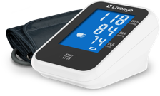
Diabetes Prevention features
Diabetes Prevention Care Complete
AN overview
Connected weight scale
One-on-one coaching
In-app tools, resources and lessons
Personalized nutrition advice
Connected blood pressure monitor (for eligible members)
Notes:
Here's another look at the key features that are included in your Diabetes Prevention program, at no additional cost.
Connected weight scale: The easy-to-use scale helps you track and measure your progress.
Expert coaching that's right for you: Expert coaches are specialists in their field. They offer one-on-one coaching that is adaptable to your schedule, ensuring you have the flexibility to make changes as needed without any commitment.
Coaching is tailored to fit into your life, focusing on your individual health needs and schedule.
Comprehensive health app: The mobile app is equipped with all the essential tools to help you stay healthy. It allows you to track your Diabetes Prevention lesson completion, activity, food intake, and weight all in one place. Our coaches will deliver nutrition feedback right to your mobile app and online account.
A best-in-class experience: You’ll receive personalized Health Nudges and other insights in your mobile app and online account. You can easily share your reports and data with your doctor.
As mentioned, eligible members may also receive a connected blood pressure monitor to further support your health goals

Slide 73
Fred v.c., Diabetes prevention program member
“I found it to be a very good program in that I don’t have to do anything different, I don’t have to count calories. I just need to eat smarter.
The testimonials, opinions, and statements reflect one member’s personal experience with Teladoc Health. Results and experiences may vary from person to person and will be unique to each member. The testimonials are voluntarily provided and are not paid.
Notes:
Speak to the testimonial and what sticks out most to you

Slide 74
Thank you
First & Last Name
Job Title
012 345 6789
Email address
PM021731.A

Slide 75
Appendix
Alternative presentation cover options

Slide 76

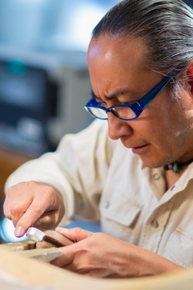
Open Enrollment Overview Guide
Insert partner logo here
2025 Benefit Year
December 4, 2024

Slide 77


Open Enrollment Overview Guide
Insert partner logo here
2025 Benefit Year
December 4, 2024

Slide 78


Open Enrollment Overview Guide
Insert partner logo here
2025 Benefit Year
December 4, 2024

Slide 79


Open Enrollment Overview Guide
Insert partner logo here
2025 Benefit Year
December 4, 2024

Slide 80


Open Enrollment Overview Guide
Insert partner logo here
2025 Benefit Year
December 4, 2024

Slide 81


Open Enrollment Overview Guide
Insert partner logo here
2025 Benefit Year
December 4, 2024

Slide 82


Open Enrollment Overview Guide
Insert partner logo here
2025 Benefit Year
December 4, 2024

Slide 83


Open Enrollment Overview Guide
Insert partner logo here
2025 Benefit Year
December 4, 2024

Slide 84


Open Enrollment Overview Guide
Insert partner logo here
2025 Benefit Year
December 4, 2024

